Slide 1
Biology of behavior
Dr.Sujit Kumar Kar, MD (Psy)
Lecturer
Department of Psychiatry
King George’s Medical University
Lucknow, U.P

Slide 2
What is behavior?
The aggregate of the responses or reactions or movements made by an organism in any situation
A complex phenomenon
Explicit
Apparently visible
Motor manifestation
The action or reaction of something under specified circumstances

Slide 4
What are the factors influencing behavior?
Biological (Age, Gender, Genetics, Neuro-hormonal factors)
Psychological (Personality)
Socio-cultural
Environmental
Contextual

Slide 6
Behavior
Aggression
Fear
Sexual response
Hunger
Social
Impulsive
Compulsive
Dis-inhibited
Disruptive
Disorganized
Demonstrative
Novelty seeking behavior
Help seeking behavior
Antisocial / criminal behavior
Avoidant behavior
Withdrawn behavior
Apathetic behavior
High risk / Risk taking behavior

Slide 7
Evolution of behavior

Slide 8
Behavior
Primitive behaviors
Aggression
Fear
Sexual response
Hunger
Social
Impulsive
Compulsive
Dis-inhibited
Disruptive
Disorganized
Demonstrative
Newer behavior in evolution

Slide 9
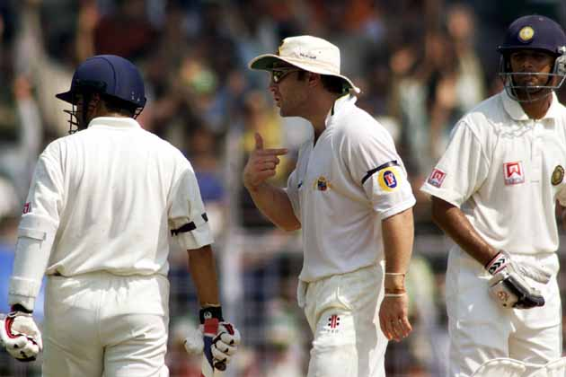
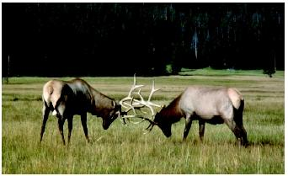
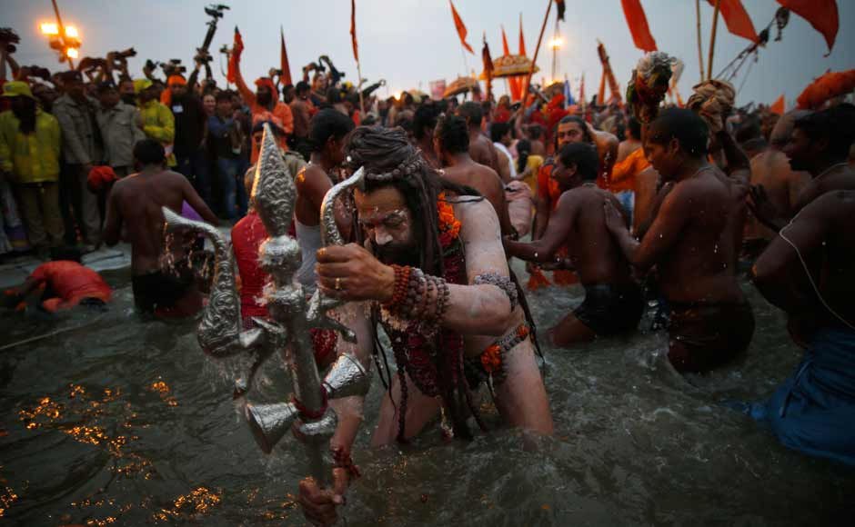
Behavior
Aggression
Fear
Sexual response
Hunger
Social
Impulsive
Compulsive
Dis-inhibited
Disruptive
Disorganized
Demonstrative

Slide 10
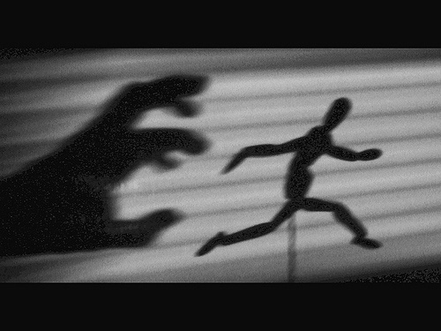
Behavior
Aggression
Fear
Sexual response
Hunger
Social
Impulsive
Compulsive
Dis-inhibited
Disruptive
Disorganized
Demonstrative

Slide 11
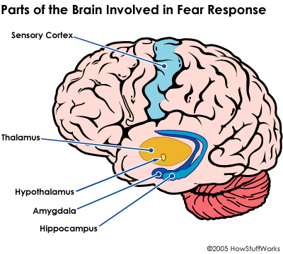

Slide 12
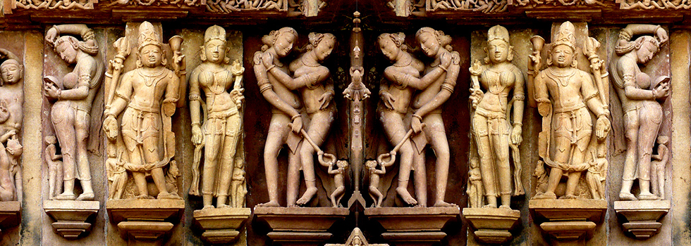
Behavior
Aggression
Fear
Sexual response
Hunger
Social
Impulsive
Compulsive
Dis-inhibited
Disruptive
Disorganized
Demonstrative

Slide 13
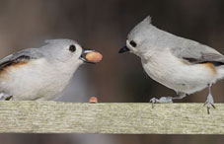
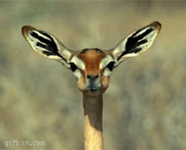
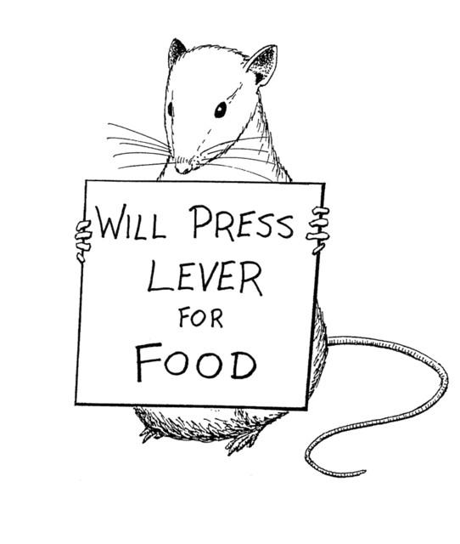
Behavior
Aggression
Fear
Sexual response
Hunger
Social
Impulsive
Compulsive
Dis-inhibited
Disruptive
Disorganized
Demonstrative

Slide 14
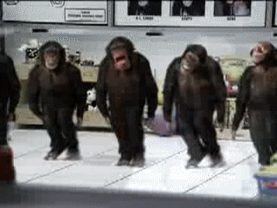
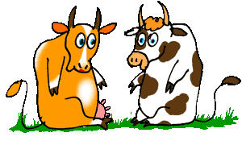
Behavior
Aggression
Fear
Sexual response
Hunger
Social
Impulsive
Compulsive
Dis-inhibited
Disruptive
Disorganized
Demonstrative

Slide 15
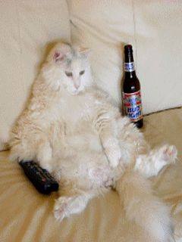
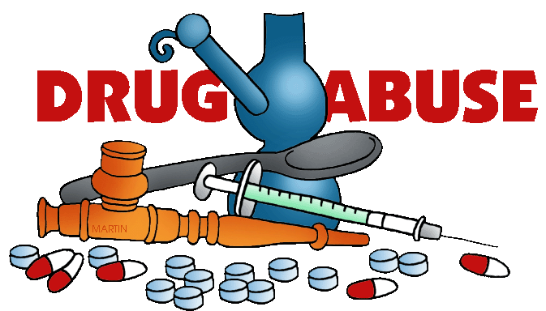
Behavior
Novelty seeking behavior
Help seeking behavior
Antisocial / criminal behavior
Avoidant behavior
Withdrawn behavior
Apathetic behavior
High risk / Risk taking behavior

Slide 16
Behavior
Novelty seeking behavior
Help seeking behavior
Antisocial / criminal behavior
Avoidant behavior
Withdrawn behavior
Apathetic behavior
High risk / Risk taking behavior

Slide 17
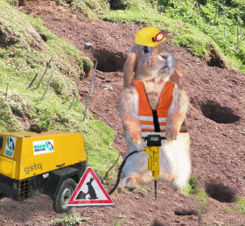
Behavior
Novelty seeking behavior
Help seeking behavior
Antisocial / criminal behavior
Avoidant behavior
Withdrawn behavior
Apathetic behavior
High risk / Risk taking behavior

Slide 18
Behavior
Novelty seeking behavior
Help seeking behavior
Antisocial / criminal behavior
Avoidant behavior
Withdrawn behavior
Apathetic behavior
High risk / Risk taking behavior

Slide 19
Behavior
Novelty seeking behavior
Help seeking behavior
Antisocial / criminal behavior
Avoidant behavior
Withdrawn behavior
Apathetic behavior
High risk / Risk taking behavior

Slide 20
Behavior
Novelty seeking behavior
Help seeking behavior
Antisocial / criminal behavior
Avoidant behavior
Withdrawn behavior
Apathetic behavior
High risk / Risk taking behavior

Slide 21
Behavior
Aggression
Fear
Sexual response
Hunger
Social
Impulsive
Compulsive
Dis-inhibited
Disruptive
Disorganized
Demonstrative

Slide 23
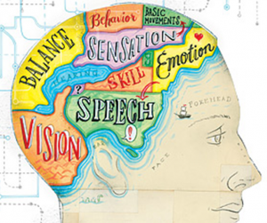

Slide 25
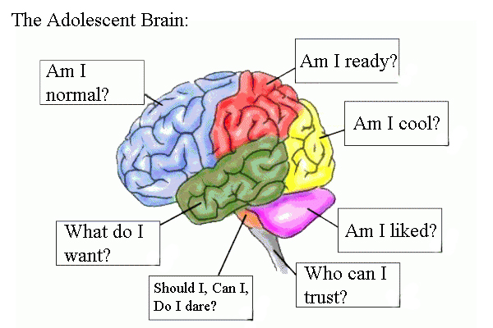
Brain & Behavior
Prefrontal cortex
Limbic system
Temporal lobe
Amygdala
Thalamus & Hypothalamus
Brainstem – RAS
Cerebellum

Slide 26
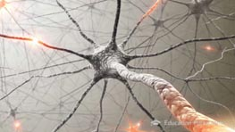
Hormonal factors
Neurotransmitters
Cortisol
Sex hormones – Androgens & female sex hormones
Thyroxine
Prolactin
Dopamine
Norepinephrine
Serotonin
Endorphins
Acetyl choline
GABA
Glutamate

Slide 27
Role of cortisol

Slide 28
Conclusion

Slide 29
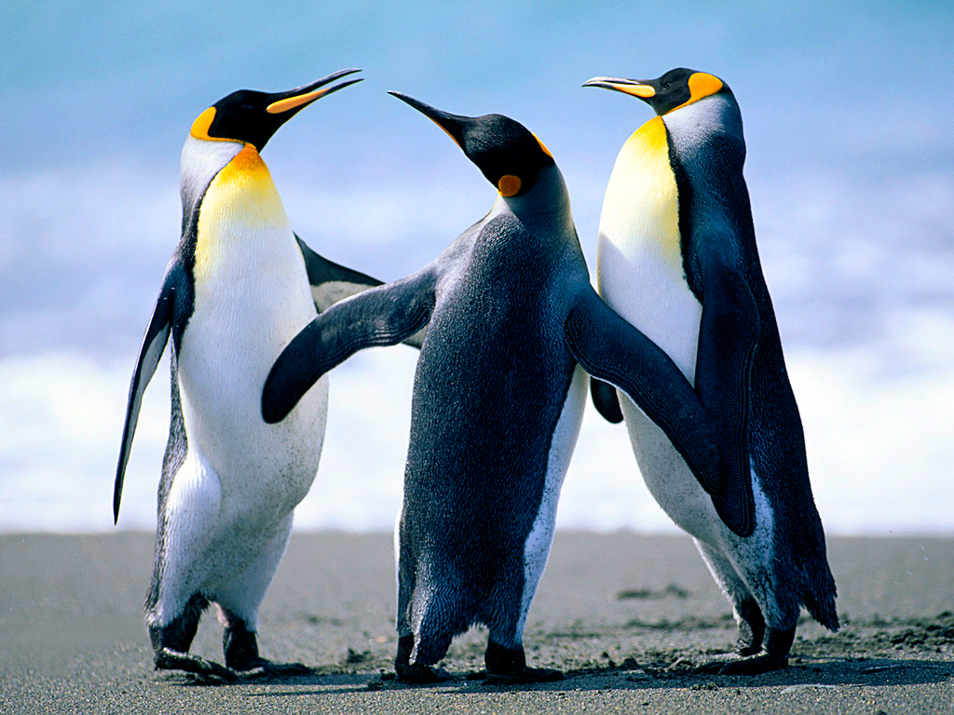
A behavior results in another behavior
A behavior is a resultant of another behavior

Slide 30
Behavior
Antecedents
Consequences

Slide 31
Normal
Abnormal

Slide 32
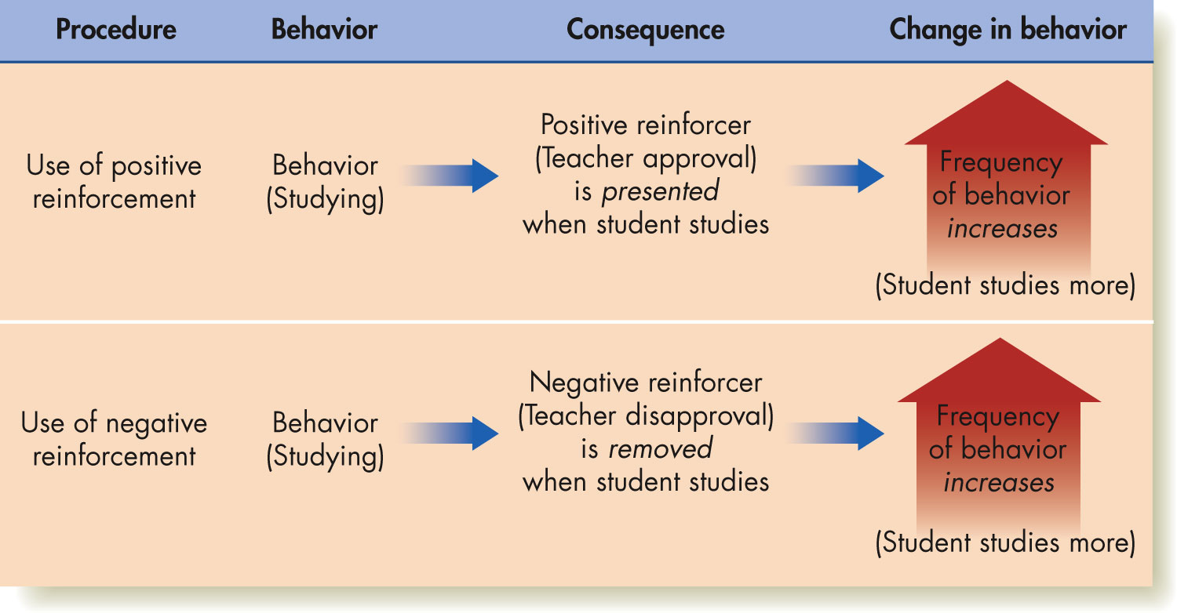

Slide 33
Behavior needs to be observed from different angles

